Slide 1
Cloud Security
Session 08
Course : COSC6100001 - Cloud Infrastructure
D6825 - Samuel Philip

Slide 2
Learning outcomes
(C4) Analysis : identify problems that can be solved using cloud global infrastructure
(C2) Comprehension : group Classify real-worlds problems in accordance with cloud computing infrastructure
(C4) Analysis : analyze identifying problems and choose proper Cloud Services and Cloud Infrastructure

Slide 3
Outline
Cloud Security Risk
Cloud Data Encryption
Virtual Machine Security
Security of Virtualization
AWS Security

Slide 4
Cloud Security Risk

Slide 5



Security Risk
for Cloud Computing
traditional security threats,
threats related to system availability,
threats related to third-party data control.

Slide 6

Traditional Security Threats
The traditional threats begin at the user site. The user must protect the infrastructure used to connect to the cloud and to interact with the application running on the cloud
This task is more difficult because some components of this infrastructure are outside the firewall protecting the user.
The next threat is related to the authentication and authorization process. The procedures in place for one individual do not extend to an enterprise.
The favorite means of attack are: distributed denial of service (DDoS) attacks that prevent legitimate users to access cloud services, phishing, SQL injection, or cross-site scripting.
This Photo by Unknown Author is licensed under CC BY-SA

Slide 7
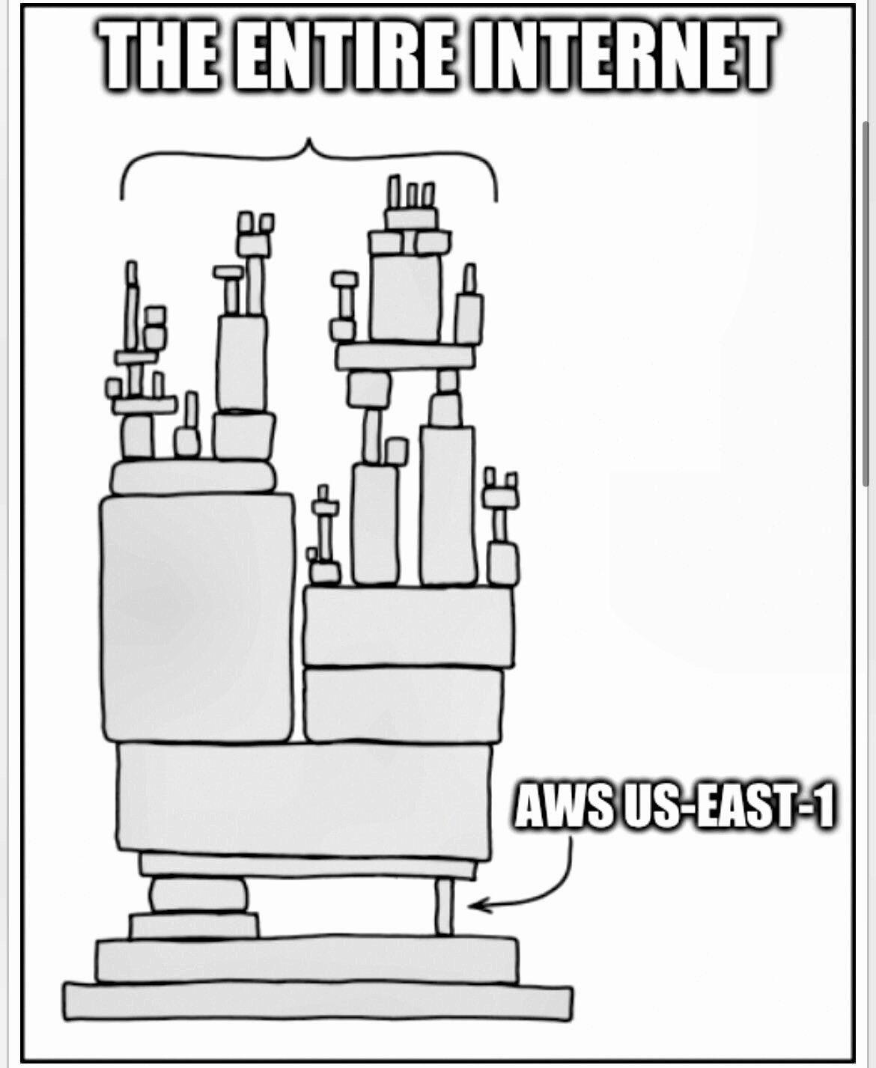
Threats Related to System Availability
System failures, power outages, and other catastrophic events could shutdown cloud services for extended periods of time.
Data lock-in could prevent a large organization whose business model depends on these data to function properly, when such a rare event occurs.
Clouds can also be affected by phase transition phenomena and other effects specific to complex systems.
Another critical aspect of availability is that the users cannot be assured that an application hosted on the cloud returns correct results.

Slide 8
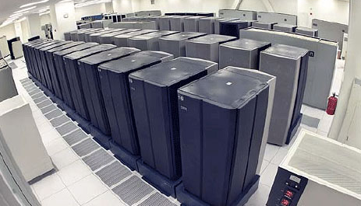
Threats Related to Third-Party Data Control
Third-party control generates a spectrum of concerns caused by a lack of transparency and limited user control.
For example, a cloud provider may subcontract some resources from a third party whose level of trust is questionable.
Storing proprietary data on the cloud is risky because cloud provider espionage poses real dangers.
The terms of contractual obligations usually place all responsibilities for data security with the user.
This Photo by Unknown Author is licensed under CC BY-SA

Slide 9
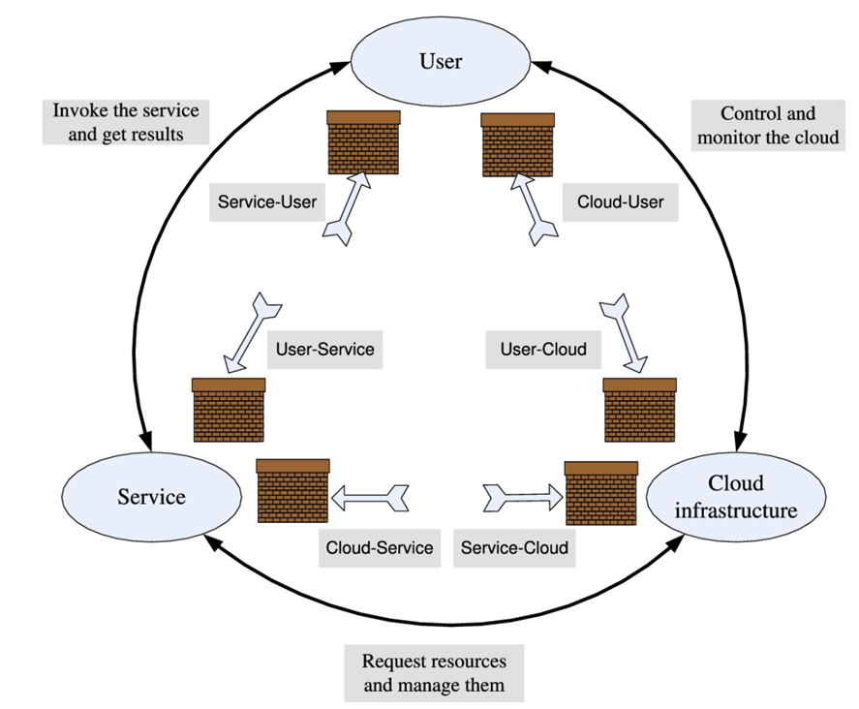
Surfaces of Attacks in a Cloud Computing Environment
The three actors involved in the model
the user, the service, and the cloud infrastructure, and there are six types of attacks possible
The user can be attacked from two directions, the service and the cloud.
Secure Sockets Layer (SSL) certificate spoofing, attacks on browser caches, or phishing attacks are example of attacks that originate at the service.
The user can also be a victim of attacks that either truly originate or that spoof origination from the cloud infrastructure.

Slide 10

Top Cloud Security Threats
Recent report by Cloud security alliance (CSA) gives 11 top threats in cloud computing
Misconfiguration and inadequate change control
Identity and Access Management
Insecure interfaces and APIs
Inadequate selection/implementation of cloud security strategy
Insecure third-party resources
Insecure software development
More on notes…
Notes:
Misconfiguration and inadequate change control
Identity and Access Management
Insecure interfaces and APIs
Inadequate selection/implementation of cloud security strategy
Insecure third-party resources
Insecure software development
Accidental cloud disclosure
System vulnerabilities
Limited cloud visibility/observability
Unauthenticated resource sharing
Advanced Persistent Threats

Slide 11
Cloud Data Encryption

Slide 12
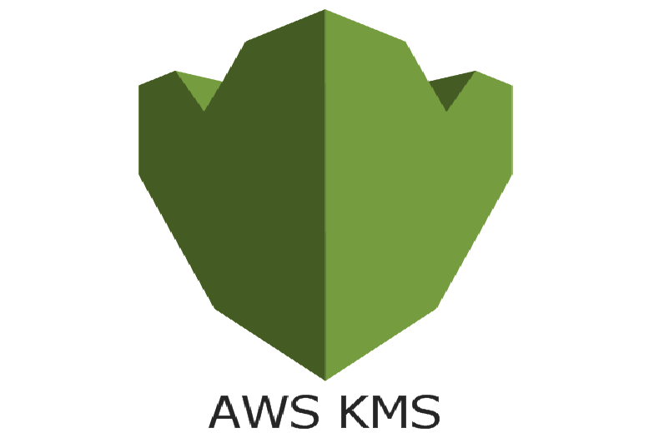
Cloud Data Encryption
Cloud service providers offer encryption services
Amazon offers AWS Key Management Service (KMS) to create and control the encryption keys used by clients to encrypt their data. KMS is integrated with other AWS services including EBS, S3, RDS, Redshift, Elastic Transcoder, and WorkMail. AWS also offers Encryption SDK for developers.
Sensitive data is safe while in storage, provided that it is encrypted with strong encryption. But encrypted data must be decrypted for processing, and this opens a window of vulnerability.

Slide 13
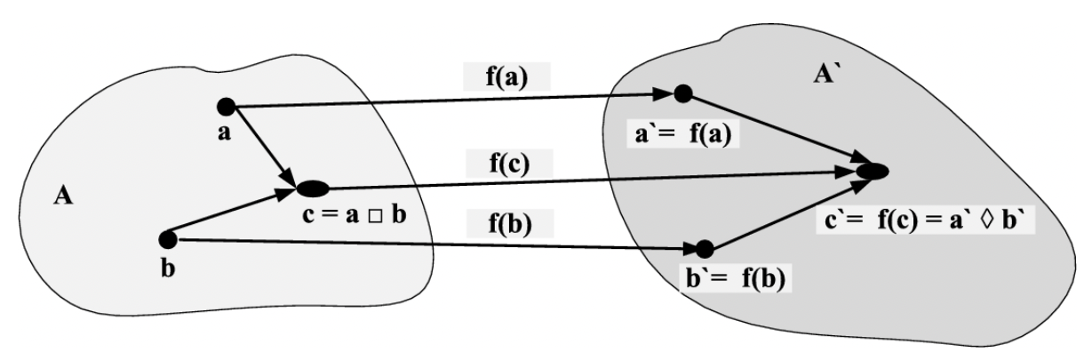
Cloud Data Encryption
Homomorphic
Homomorphic encryption reflects the concept of homomorphism, a structure-preserving map f(⋅) between two algebraic structures of the same type
The homomorphism shows that we can conduct arithmetic and/or logic operations with encrypted data and the decryption of the result of these operation replicates the result of carrying out the same operations with the plaintext data. This implies that the window of vulnerability created when data is decrypted for processing disappears
Notes:
When f(⋅) in Figure is a one-to-one mapping, the inverse of f(⋅) is f−1:A′→A and a=f−1(a′), b=f−1(b′), c=f−1(c′). In this case, we can carry out the operation ⋄ in the target domain and apply the inverse mapping to get the same result produced by the □ operation in the original domain, f−1(a)⋄f−1(b)=f(a□b). In the case of homomorphic encryption, the map is a one-to-one transformation, f(⋅) is the encryption procedure, its inverse, f−1(⋅), is the decryption procedure, and the composition operation can be any arithmetic and logic operation.

Slide 14
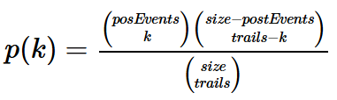
Order Preserving Encryption (OPE)
Order Preserving Encryption (OPE) [66] can be used for encryption of numeric data. OPE maps a range of numerical values into a much larger and sparse range of values.
To encrypt plaintext x, the OPE encryption algorithm performs a binary search down to x.
Given the secret key K, the algorithm first assigns Encrypt(K,M/2), then Encrypt(K,M/4) if the index m<M/2 and Encrypt(K,3M/4) otherwise, and so on, until Encrypt(K,x) is assigned.
Each ciphertext assignment is made according to the output of the negative hypergeometric sampling algorithm.
One can prove by strong induction on the size of the plaintext space that the resulting scheme induces a random order-preserving function from the plaintext to ciphertext space.

Slide 15
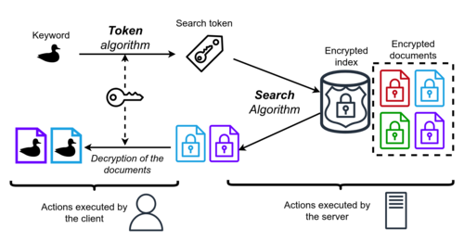
Searchable Symmetric Encryption (SSE)
Searchable symmetric encryption (SSE) is used when an encrypted databases E is outsourced to a cloud or to a different organization.
SSE hides information about the database and the queries.
A client only stores the cryptographic key. To search a database, the client encrypts the query, sends it to the database server, receives the encrypted result of the query, and decrypts it using the cryptographic key.
Information leakage from these searches is confined to query patterns, while disclosure of explicit data and query plaintext values is prevented.
Notes:
An SSE protocol supporting conjunctive search and general Boolean queries on symmetrically encrypted data. This SSE protocol scales to very large databases. It can be used for arbitrarily structured data including free text search with the moderate and well-defined leakage to the outsourced server.

Slide 16
Virtual Machine Security

Slide 17
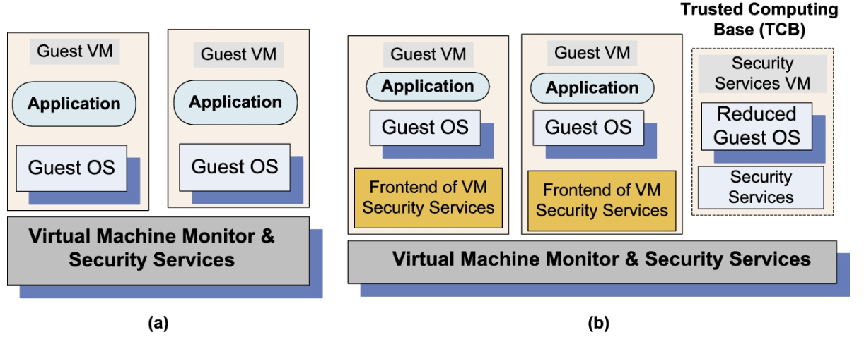
Virtual Machine Security
Virtual security services are typically provided by the hypervisor as shown in (a);
another alternative is to have a dedicated VM providing security service as in (b).
A secure TCB (Trusted Computing Base) is a necessary condition for security in a VM environment. When TCB is compromised, the security of the entire system is affected.

Slide 18
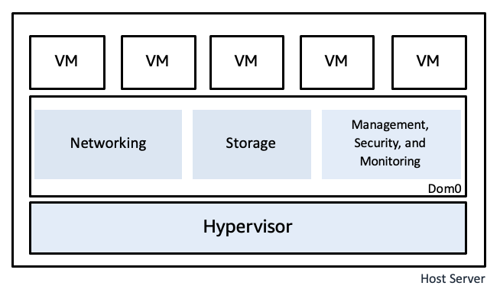
Virtual Machine Threats
Hypervisor-based
4 most common attack on hypervisor-based Threats:
Resources starvation and denial of service -> bad configuration
VM side-channel attacks -> lack of proper isolation
Buffer overflow attacks
Notes:
Resources starvation and denial of service for some VMs. Probable causes: (1) badly configured resource limits for some VMs; (2) a rogue VM with the capability of bypassing resource limits set in hypervisor.
VM side-channel attacks: malicious attack on one or more VMs by a rogue VM under the same hypervisor. Probable causes: (1) lack of proper isolation of inter-VM traffic due to misconfiguration of the virtual network residing in the hypervisor; (2) limitation of packet-inspection devices to handle high-speed traffic, e.g., video traffic; (3) presence of VM instances built from insecure VM images, e.g., a VM image having a guest OS without the latest patches.
Buffer overflow attacks.

Slide 19
Virtual Machine Threats
VM-based
Not only hypervisor-based, threats also exists in VM
Deployment of rogue or insecure VM -> improper configuration of access controls
Presence of insecure and tampered VM images in the VM image repository
Notes:
deployment of rogue or insecure VM; unauthorized users may create insecure instances from images or may perform unauthorized administrative actions on existing VMs. Probable cause: improper configuration of access controls on VM administrative tasks such as instance creation, launching, suspension, re-activation, etc.;
Presence of insecure and tampered VM images in the VM image repository. Probable causes: (i) lack of access control to the VM image repository; (ii) lack of mechanisms to verify the integrity of the images, e.g., digitally signed image.

Slide 20
Security of Virtualization

Slide 21
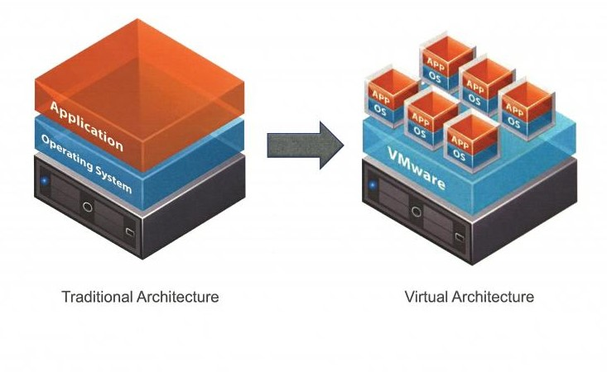
Useful Implication of Virtualization
Supports the IaaS delivery model.
Increased reliability.
Straightforward mechanisms for implementing resource management policies.
Improved intrusion detection.
Secure logging and intrusion protection.
More efficient and flexible software maintenance and testing.
This Photo by Unknown Author is licensed under CC BY

Slide 22
Undesirable Effects of Virtualization
The number of physical systems in the inventory of an organization is limited by cost, space, energy consumption, and human support.
In addition to a quantity, there is also a qualitative side to the explosion of the number of VMs.
One of the most critical problems posed by virtualization is related to the software lifecycle.
This Photo by Unknown Author is licensed under CC BY

Slide 23
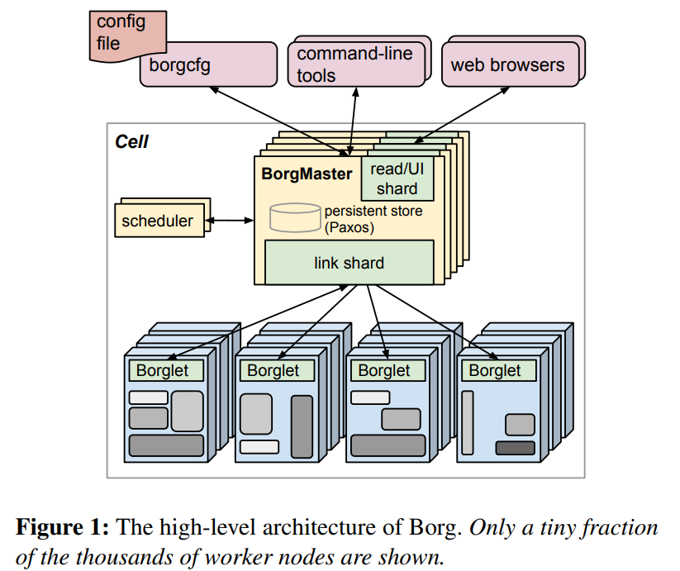
Evolution of a cluster management system
Study case from google
The 2019 scheduler is more agile and has to work harder, the number of jobs to be scheduled is seven times higher, and most of the workload has moved into the high-priority best-effort batch tier.
The heavy-tailed distribution of job sizes and the power law Pareto distribution with heavy tail of computing cycles and memory add to the scheduling challenges of 2019 Borg.
Significantly improved scheduling decisions led to an increase of both average CPU and memory utilization: 20–40% for CPU and 3–30% for memory.
The utilization variance is lower, and there were fewer servers with utilization larger than 80%. Median scheduling delays decreased, but the tail is longer for the last 28% of jobs.

Slide 24
Vulnerability Caused by Events Recorded in The Memory
The first is that one-time passwords are transmitted in the clear, and the protection is guaranteed only if the attacker does not have the possibility to access passwords used in previous sessions. An attacker can replay rolled-back versions and access past sniffed passwords if a system runs the S/KEY password system.
The second is related to the requirement of some cryptographic protocols and even noncryptographic protocols regarding the “freshness” of the random number source used for session keys and nonces. This occurs when a VM is rolled back to a state when a random number has been generated but not yet used.
Another undesirable effect of virtual environment affects trust. Trust is conditioned by the ability to guarantee the identity of entities involved. Each computer system in a network has a unique physical, or MAC address. The uniqueness of the MAC address guarantees that an infected or a malicious system can be identified and then shut down, or denied network access.

Slide 25
Cloud security: AWS Security

Slide 26
AWS Security tools
CloudTrail is a service that enables governance, compliance, operational auditing, and risk auditing of an AWS account. The event history, including Management Console activity, AWS SDK (Software Development Kit), and all AWS services invoked, simplifies security analysis, resource change tracking, and troubleshooting.
The Inspector (IS) is an automated security assessment service; it assesses applications for exposure, vulnerabilities, and deviations from best practices. After performing an assessment, IS produces a detailed list of security findings prioritized by level of severity and checks for unintended network accessibility of EC2 instances and for vulnerabilities on those EC2 instances.
Web Application Firewall (WAF) protects web applications or APIs against common web exploits and bots that may compromise security, consume excessive resources, or affect availability. WAF provides control over the traffic generated by applications and blocks attack patterns, such as SQL injection13 or cross-site scripting (XSS).

Slide 27
AWS Security tools
Cognito is used for identity management. It can detect brute-force authentication and fraudulent login attempts. Cognito User Pools supports identity and access management standards, such as Oauth 2.0, SAML 2.0, and OpenID Connect.
CloudHSM helps generate encryption keys using managed hardware security modules. An AWS user can configure the Key Management Service (KMS) to use CloudHSM cluster as a custom key store, rather than the default KMS key store. It automatically load balances requests and securely duplicates keys stored in any HSM to all of the other HSMs in a cluster.
CloudFront is a content delivery network. It protects applications from DDoS attacks and transfers data securely at high speeds. It offers security capabilities, such as field level encryption and HTTPS support, seamlessly integrated with Shield, WAF, and Route 53 to protect against multiple types of attacks including network and application layer DDoS (Distributed Denial of Service) attacks.

Slide 28
The Most Consequential Aspects of AWS Security
Fine-grain identity, access controls, and continuous monitoring for near real-time security information.
Automation to reduce human configuration errors.
Extended use of encryption. Data flowing across the AWS global network is automatically encrypted at the physical layer before leaving a secured facilities.
The added level of competence provided by a global program of Technology and Consulting Partners specialized in security—the AWS Partner Network.

Slide 29
Exercise
Find cases about cloud security gone wrong, provide your solutions to fix it

Slide 30
References
Marinescu, Dan C. (2022). Cloud Computing Theory and Practice: 3rd Edition. Morgan Kaufmann Publishers. ISBN: 978-0-323-85277-7

Slide 31
Thankyou

